Slide 1
PICT Case Finding
SIYENZA GUIDANCE

Slide 2
Strategies for PICT Case Finding
Diagnostic Testing: testing of patients who present with signs or symptoms suggestive of HIV
Targeted Testing: testing of subpopulations of increased risk due to behavioral, clinical, or demographic characteristics, or a combination of these such as STI clients, alcohol abuse, or high burdened areas
Universal screening: testing all patients presenting for medical attention regardless of presenting complaint

Slide 3
PEPFAR COP GUIDANCE
Diagnostic testing or targeted, risk-based testing should only be used once ART coverage is over 70% in a country or SNU, and yield should be at least 10%. (p.344 COP 19 Guidance).

Slide 4
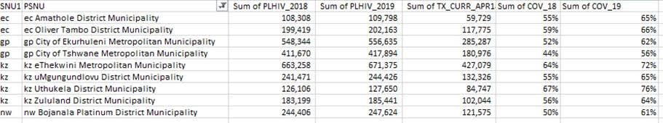
ART COVERAGE FOR SIYENZA DISTRICTS
ART coverage not >70% in any district

Slide 5
SIYENZA PICT Strategy
Case finding guidance for Siyenza facilities should be based on HIV testing coverage (proportion of eligible clients who have been tested for HIV):
TIER 1 facilities are facilities where HIV testing coverage is <80% for all clients, no matter the yield. These facilities should consider opt-out, universal screening.
TIER 2 facilities are facilities where HIV testing coverage is ≥80% with <5% yield. These facilities should consider targeted testing.
Note: 80% HIV testing coverage was a CDC SA programmatic decision

Slide 6
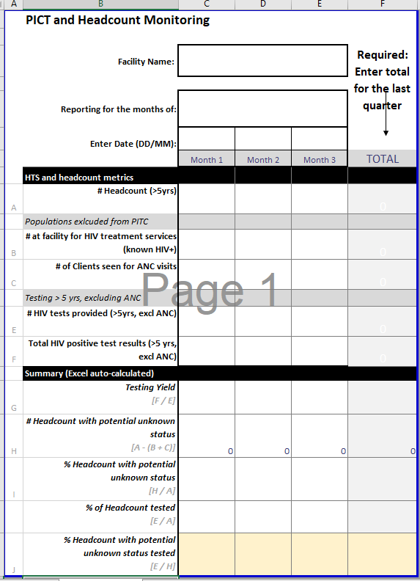
Tier 1 / Tier 2 Determination
Review current monthly headcount vs. testing coverage (Proportion of Eligible Clients) for past quarter
Use HTS metrics to calculate

Slide 7
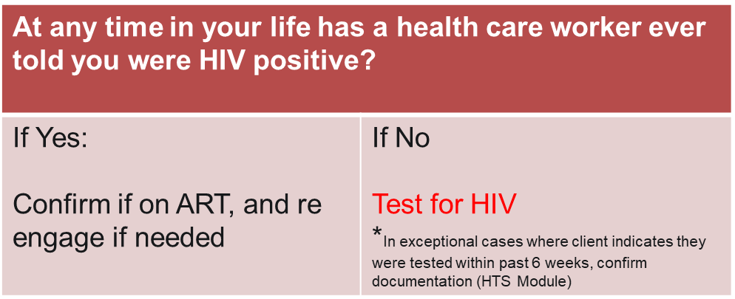
Tier 1: Facilities with a less than 80% HIV testing of proportion of the eligible headcount HIV no matter the yield: Universal Screening Approach
Screening Questions:

Slide 8
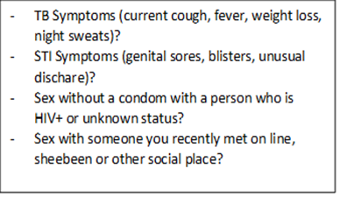
Tier 2 Facilities: (≥80% of eligible clients have been tested for HIV) but the yield is less than 5%: Targeted Testing Approach
Screening Questions:
Question | Y/N | Recommendation
At any time in your life has a health care worker ever told you were HIV positive? |  | If Yes : Confirm if on ART, and re-engage if needed If No: Go to next question
In the last year*, has a healthcare provider tested you for HIV? |  | If No: test for HIV If Yes: Go to next question
Does the client have documentation of negative prior HIV test? |  | If No: test for HIV If Yes: Screen Further for STI, TB and recent exposure
*Emphasize the change from 3 months to 12 months as this aligns with the National HTS Testing Retesting Guidelines of annual testing in absence of recent risk
If YES to any 1 of these, test for HIV

